Slide 1


Krypturg Web Application
Submitted to :
Mr. Anuj Kumar
Submitted by :
Rochak Sharma
Id : AF0350890
Batch Code : ANP-C6985

Slide 2
TABLE OF CONTENTS
What is e commerce?
Our System
Key features
Technologies Used
Screenshots
Advantages
Limitations
Conclusion

Slide 3
What is E Commerce ?
Commonly known as electronic marketing.
Electronic commerce (e-commerce) refers to companies and individuals that buy and sell goods and services over the internet.
E-commerce operates in different types of market segments and can be conducted over computers, tablets, smartphones, and other smart devices.

Slide 4
Our System
Our System i.e Krypturg-Web-App is an e-commerce website from where people can buy computer products and its peripheral devices online.
One of the main feature is that the user has the option to customize his computer specification under the tab Build My PC.
Admin monitors the activity of the users and checks the transactions
The purpose of this project is that company can sell their product online and earn cash.
E-commerce is the buying and selling of goods and services, or the transmitting of funds or data, over an electronic network, primarily the Internet.

Slide 5
Key features :
Virtual PC Configuration: Users visualize their customized PC setups in real-time.
Integration with Tech Forums: Connects users with tech communities for advice.
Exclusive Deals: Offers special discounts on selected products.
Expert Consultation: Schedule sessions with tech experts for personalized assistance.
DIY Assembly Guides: Step-by-step tutorials for users assembling their PCs.
Cross-Platform Sync: Synchronizes user accounts and shopping carts across multiple devices for seamless browsing and purchasing.
Localized Payment Options: Provides various payment methods tailored to different regions, accommodating diverse customer preferences.
Real-Time Inventory Updates: Ensures product availability with automatic updates on stock levels, minimizing the risk of out-of-stock items

Slide 6







Technologies used

Slide 7
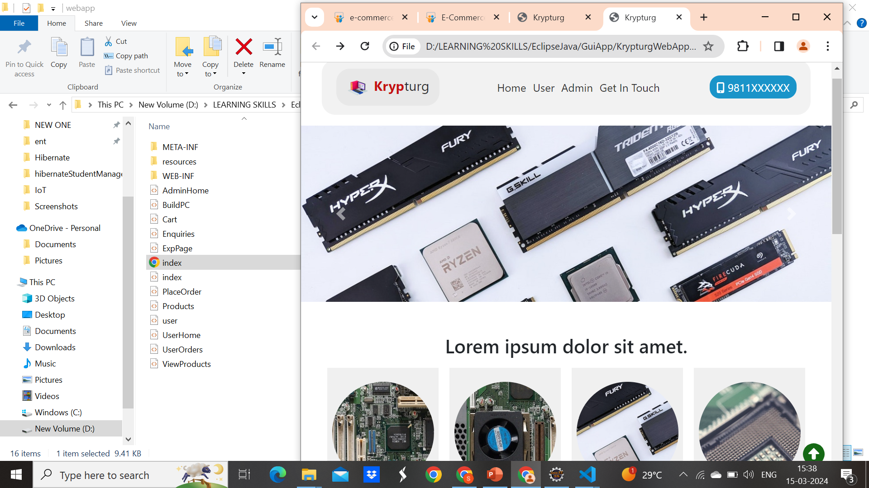
Home Page

Slide 8
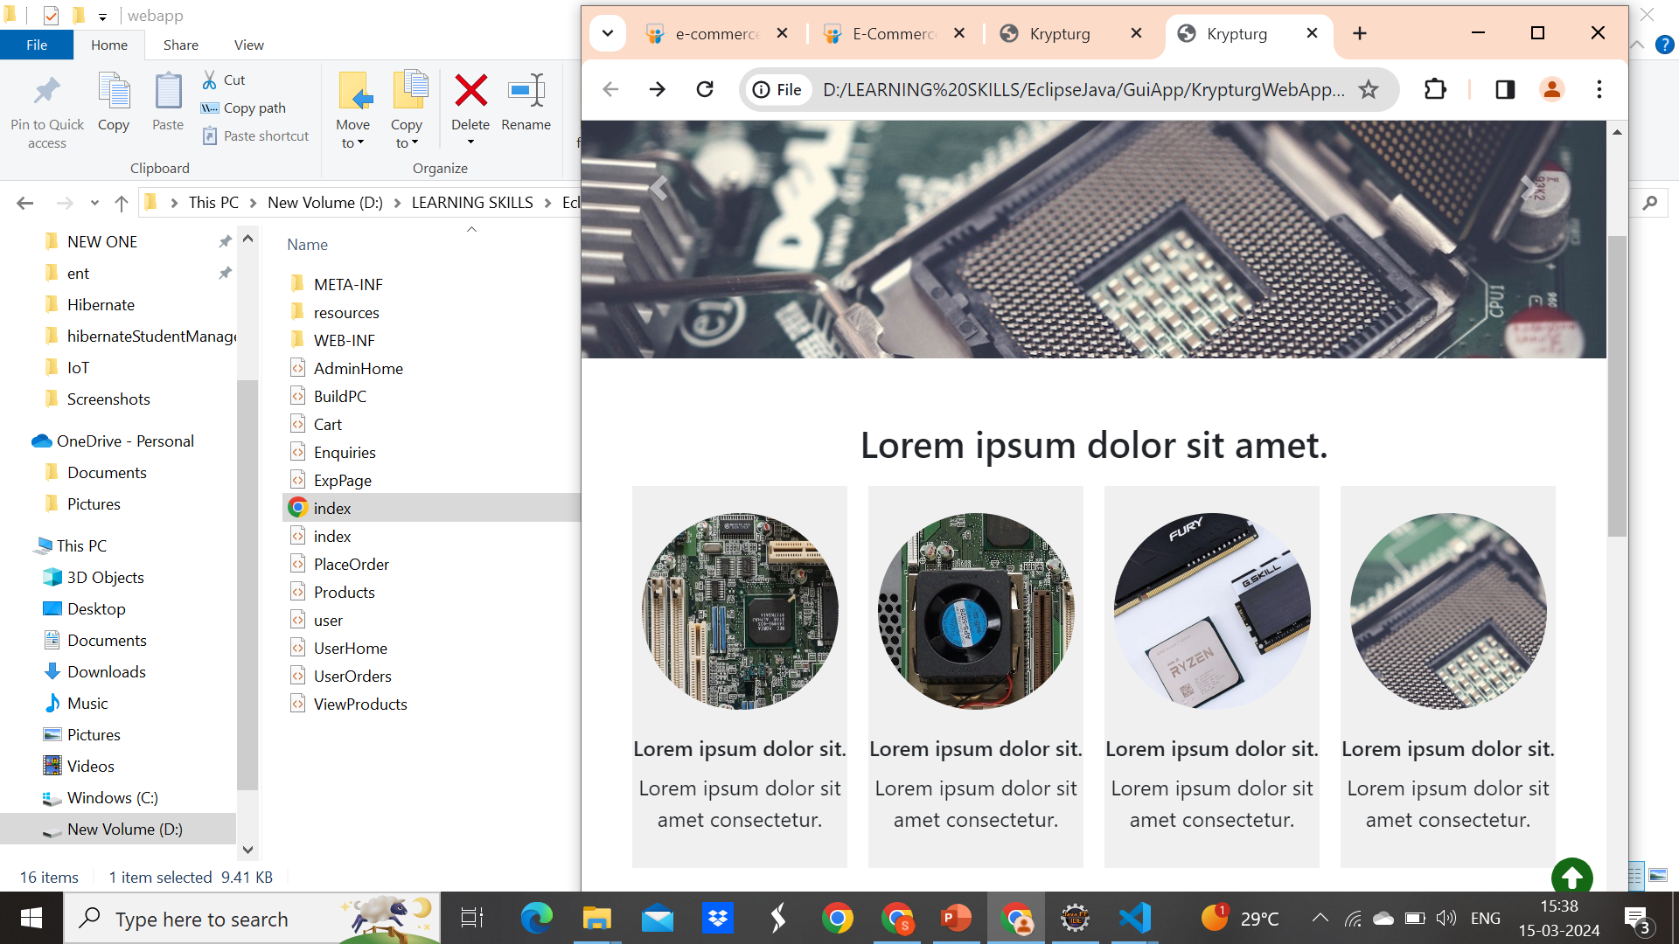

Slide 9
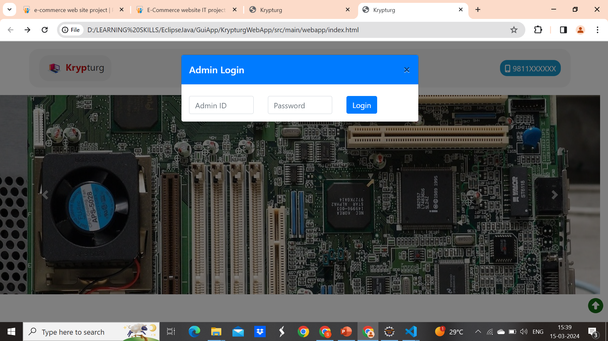

Slide 10
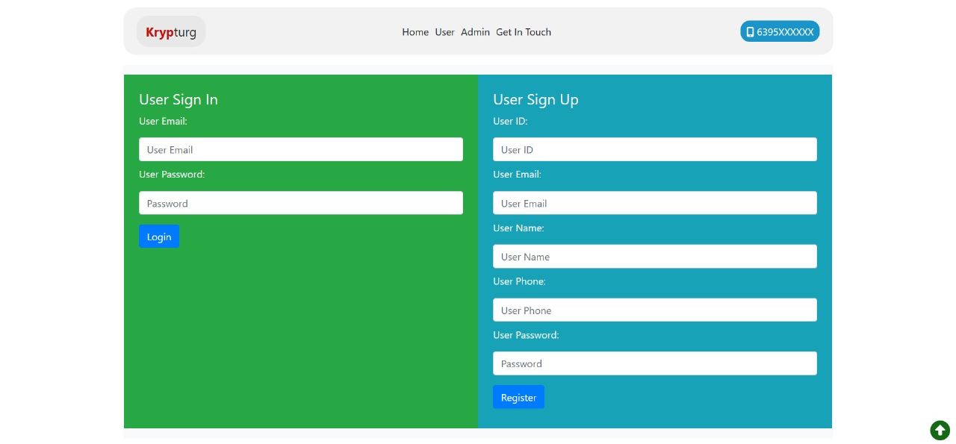
Login & Registration Page

Slide 11
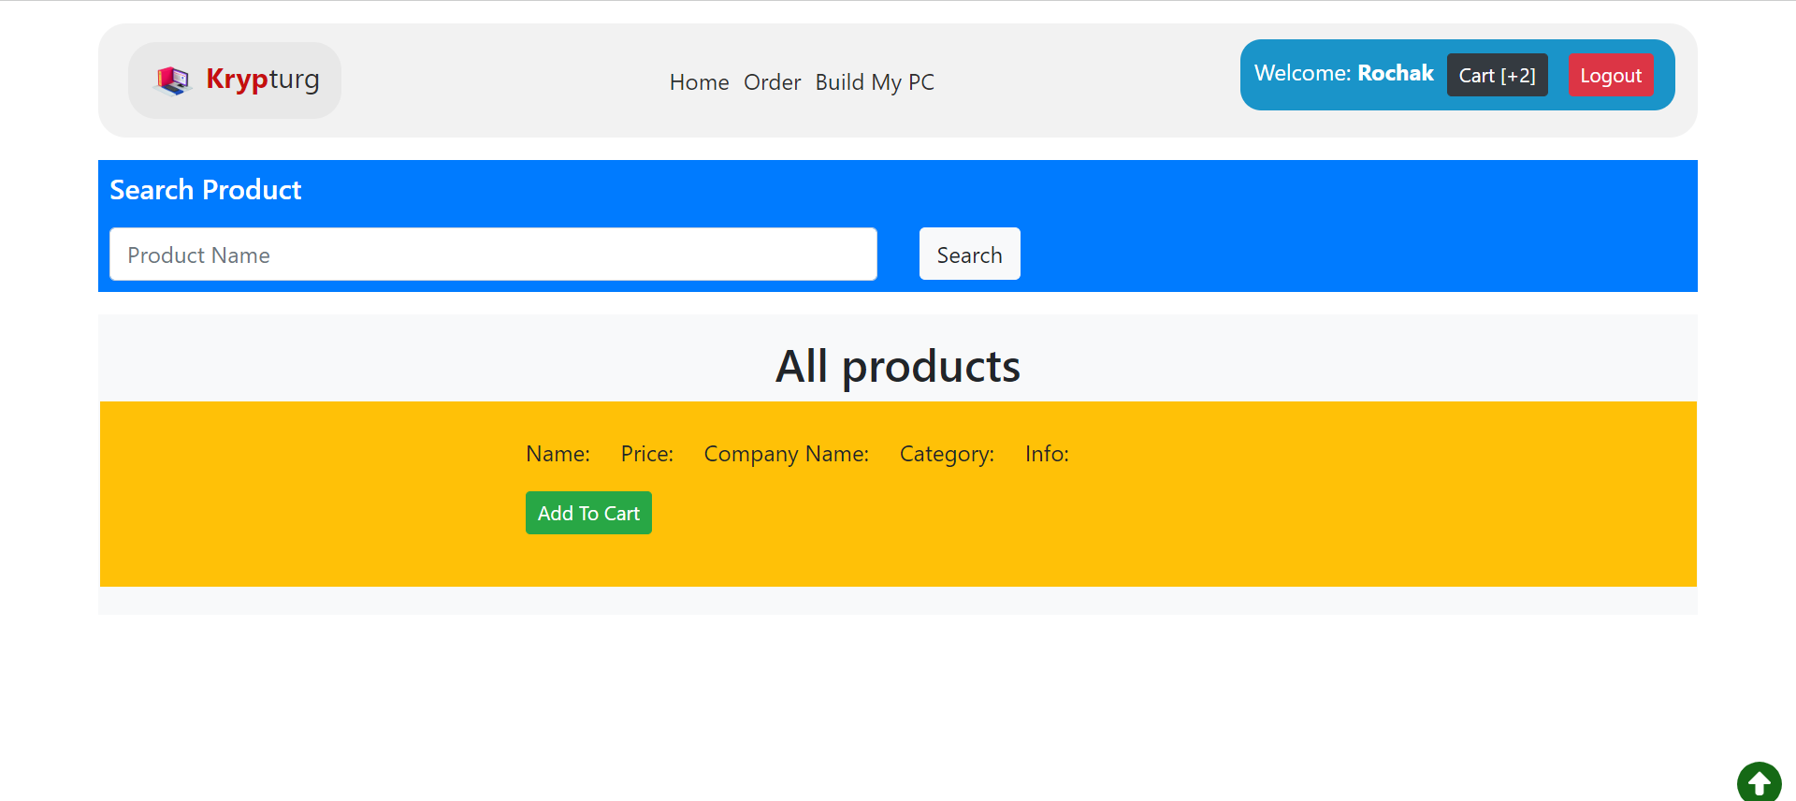
User Page

Slide 12
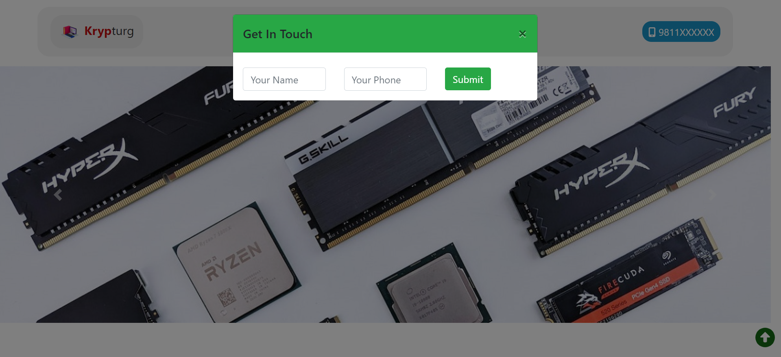
Enquiry form

Slide 13
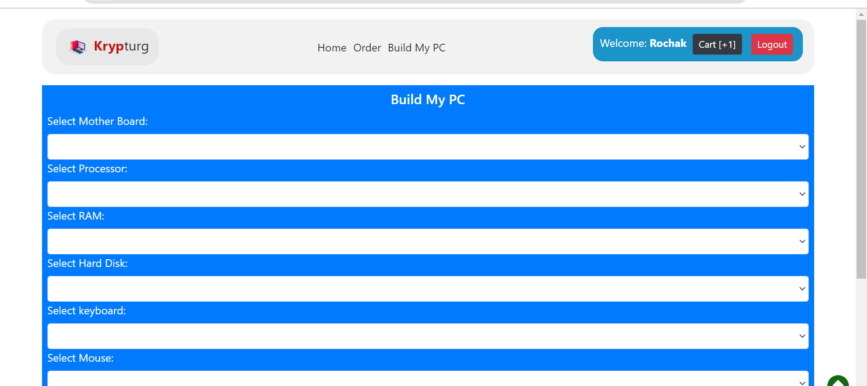
Build My PC Page

Slide 14
Advantages of Krypturg Web APP
Speed and Convenience: Faster buying/selling process, easy product discovery.
24/7 Availability: Allows transactions at any time, providing round-the-clock service to customers.
Global Market Reach: Overcomes geographic limitations, expanding customer base globally.
Cost Efficiency: Lower operational costs compared to physical stores, leading to better profit margins.
Quality of Service: Enhanced customer service through features like live chat support and personalized recommendations.
Flexibility and Ease of Management: Easy to start and manage a business with minimal capital investment and greater flexibility in operations.

Slide 15
Limitations :
Limited Product Inspection: Customers can't physically examine products, potentially leading to dissatisfaction upon delivery.
Digital Accessibility Divide: Not everyone has internet access, reducing the potential customer base.
Security Risks: Concerns about credit card theft and cybercrimes may undermine trust in online transactions.
Technical Vulnerabilities: Mechanical failures or technical issues can disrupt operations, leading to lost sales and reputational damage

Slide 16
Conclusion
In conclusion, Krypturg-Web-App serves as a robust e-commerce platform specializing in computer products and peripherals. With its innovative features such as the "Build My PC" customization option and diligent user monitoring by the admin, the platform aims to provide a seamless and secure online shopping experience. While the primary goal is to drive online sales and revenue generation for the company, Krypturg-Web-App exemplifies the transformative potential of e-commerce in catering to diverse consumer needs in the digital age.

Slide 17


